Slide 1
Implication of near-term policies for long-term stabilization
The role of path dependency in energy systems for mitigation pathways
Keywan Riahi and Nils Johnson (IIASA), Christoph Bertram (PIK), Meriem Hamdi-Cherif and Aurélie Méjean (SMASH-CIRED),
The AMPERE Consortium
The AMPERE project in funded by the European Union’s Seventh Framework Programme FP7/2010 under grant agreement n° 265139 (AMPERE)

Slide 2
Acknowledgement
The AMPERE project in funded by the European Union’s Seventh Framework Programme FP7/2010 under grant agreement
n° 265139 (AMPERE).
The information presented here reflects only the authors’ views. The European Union is not liable for any use that may be made of the information contained herein.

Slide 3
Key findings

Slide 4
Emissions Budget to Limit Global Warming to 2°C
Reaching 2°C requires adherence to a tight global emissions budget
Cumulative CO₂ emissions need to stay within about 1000 GtCO₂
Requires fundamental and rapid transformations
Current global policies are insufficient to reach the 2°C objective
Global warming is projected to reach 3.2-3.8°C this century
Global GHG emissions

Slide 5
Near-term Policies to Limit Global Warming to 2°C
Near-term climate action by 2030 will be critical
Continuation along current pledges exhausts ~70% of the emissions budget by 2030
The lack of near-term mitigation needs to be compensated by massive emissions reductions later in time
Delays exuberate technical, economic, social and political challenges
The findings suggest global GHG emissions targets of less than 50 GtCO₂ by 2030
Implications of delayed action
for reaching 2°C

Slide 6
Detailed findings

Slide 7
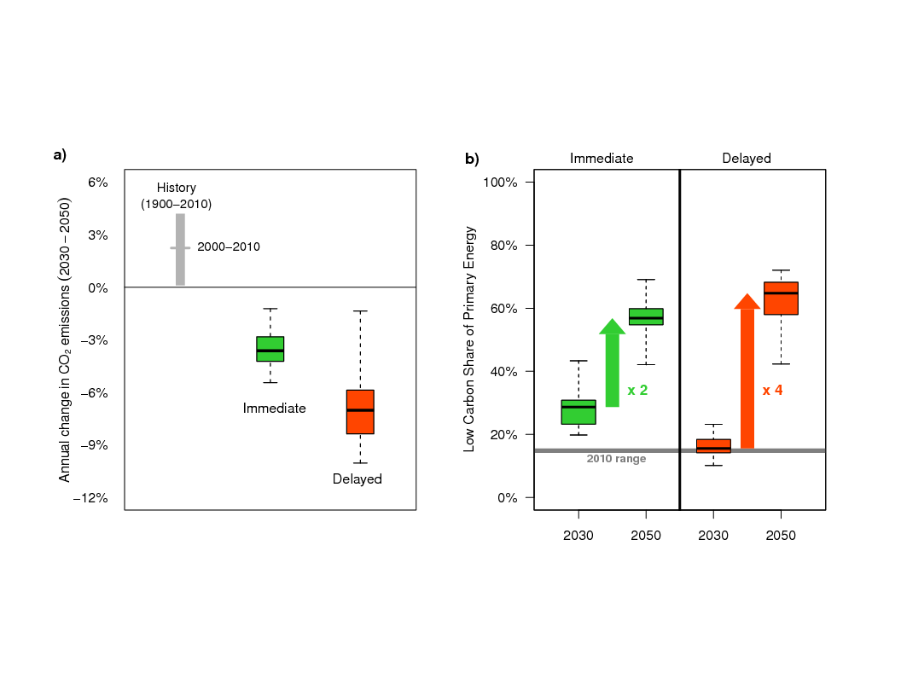
Emission Reductions
Consequences of delayed action
Massive acceleration of the transformation post 2030
  global emissions reductions
  Low-carbon energy technology diffusion
Stranded assets (coal power plants)
  lock-in of fossil-intensive infrastructure
  Premature shutdown of this infrastructure post 2030 needed
  Construction of new coal power plants should be avoided
Higher mitigation costs
  Overall mitigation costs increase by 10-40%
  Transitional costs increase by 25-60%
Increased risk that the 2°C target becomes infeasible
  Many AMPERE models could not reach the target under delayed action assumptions
Upscaling of Low-Carbon Energy

Slide 8
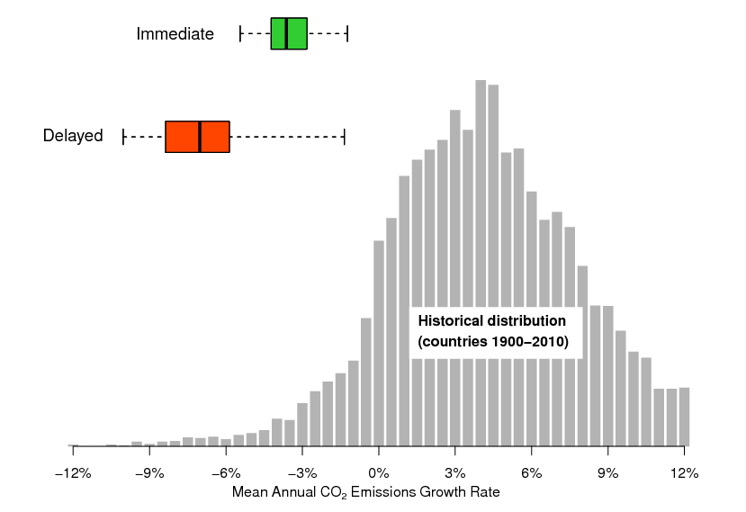
CO₂ reduction rate
Collapse of the Soviet Union
2-4 % per year
Sweden and France after the
oil crisis: 2-3 % per year
>4% Europe during
WWI & WWII

Slide 9
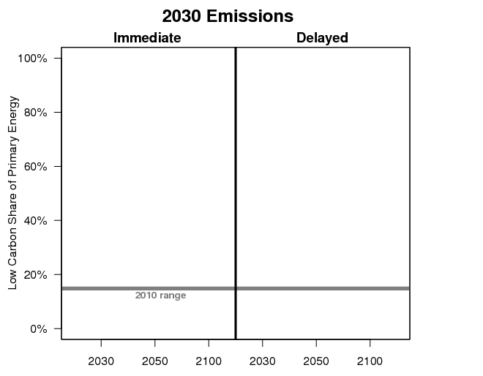
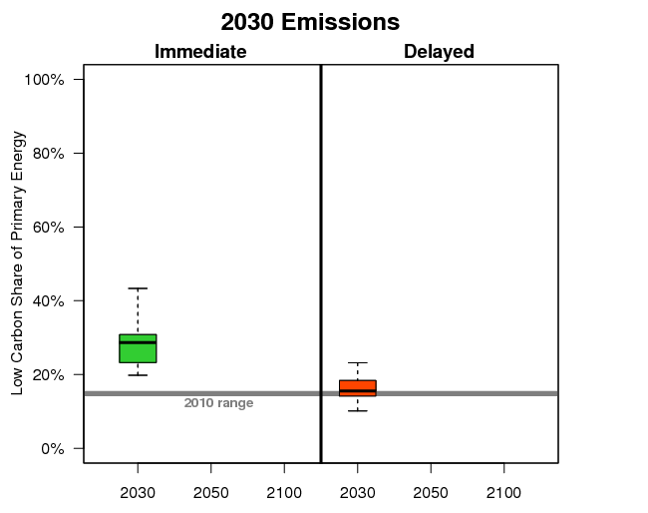
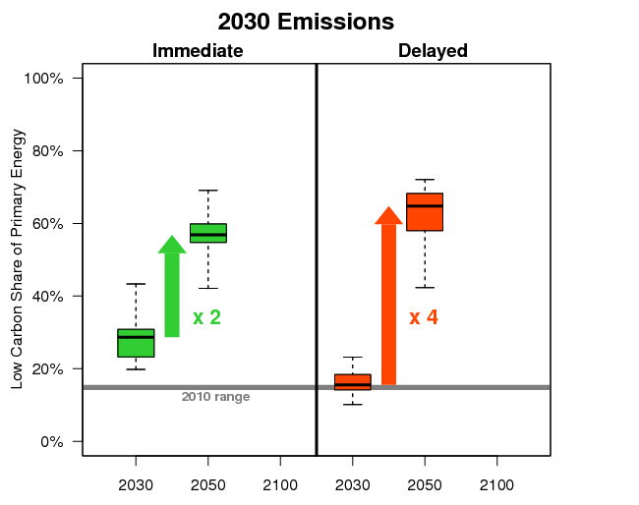
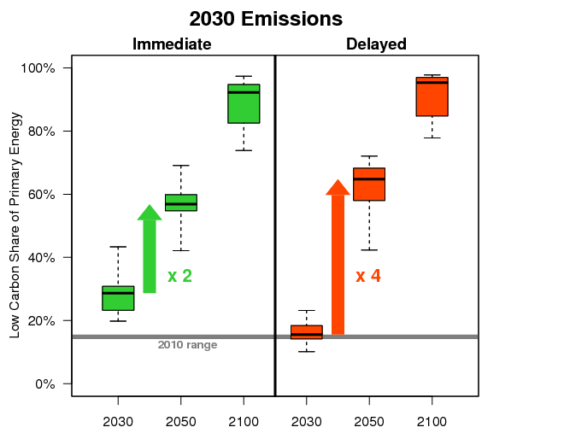
Contribution of Low-Carbon Energy
(Renewables, nuclear & fossil fuels with CCS)
2100
2050
2030

Slide 10
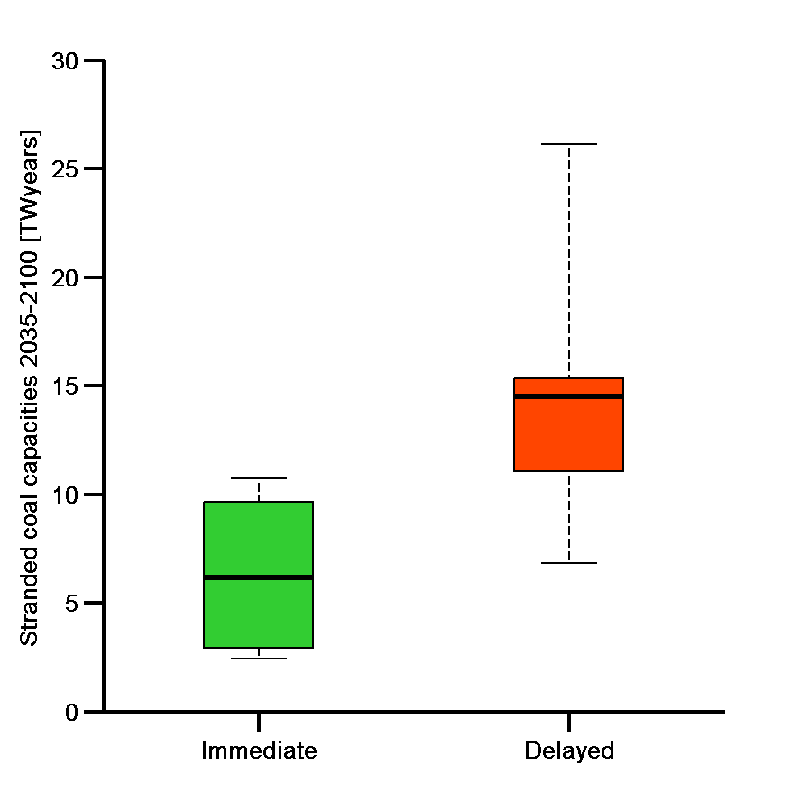
Implications of Pledges to 2030
(Bertram et al)
Double-challenge:
Acceleration of the low-carbon transformation
Dealing with consequences of fossil-fuel “lock-in”
→ stranded assets in the order of 100s of GW coal power plants
Stranded assets (coal power plants)
*Current global electricity generation in 2010 = 2.5 TWyr

Slide 11
Stranded investments by Region
(Johnson et al)
Rest of the world
China
Africa
Europe
MENA
South Asia
USA + Canada
Source: MESSAGE model
Current global energy-related investments are in the order of 1000 billion

Slide 12
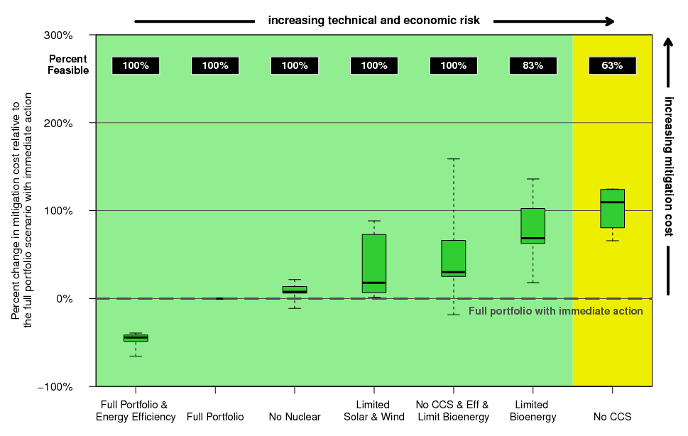
The value of technology
Mitigation costs of immediate action

Slide 13
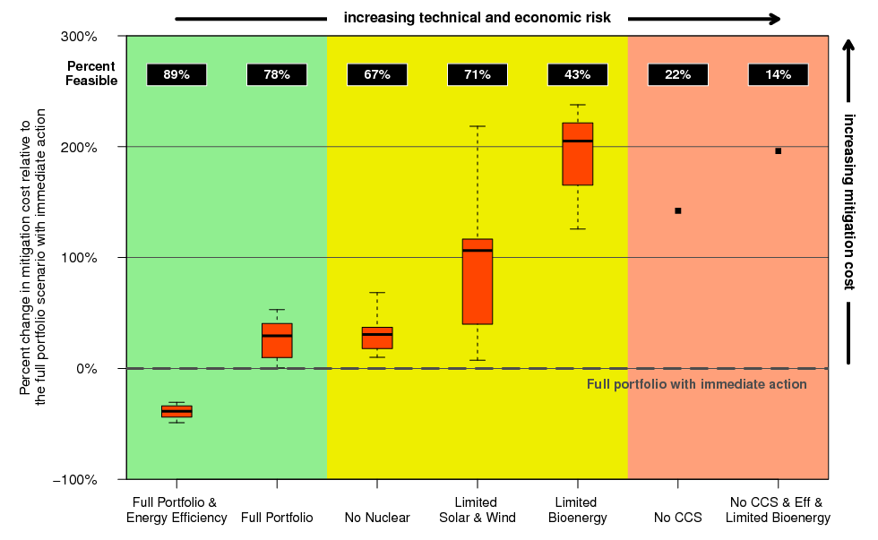
The value of technology
Mitigation costs of delayed action
Efficiency!!
Low risk & low cost

Slide 14
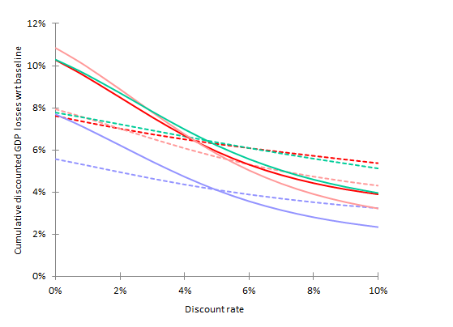
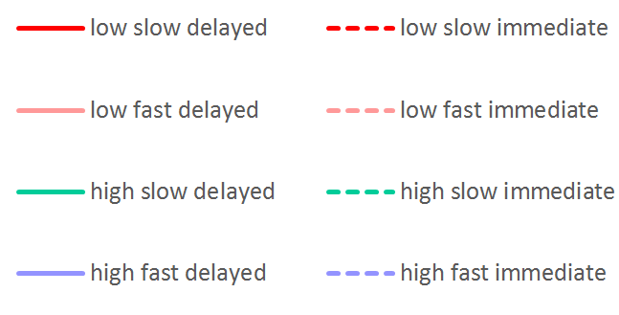
Energy efficiency policies reduce mitigation costs
High long-term cost
of delayed action
COST RANGE
LEGEND
Low vs. high
energy efficiency level in industrialized regions
Slow vs. fast
catching-up speed of other regions
Delayed vs. immediate
timing of climate mitigation action
delayed
action
High short-term cost
of immediate action
immediate
action
Long term Medium term Short term
Energy efficiency policies ⇒ Lower CO₂ price & production costs ⇒ Lower mitigation costs
Immediate climate action reduces the cost uncertainty related to the choice of the discount rate
Short-term costs of immediate action are high but can be reduced by energy efficiency policies
(Bibas et al.)

Slide 15
Special Issue papers on delays to 2030:
(Technological Forecasting and Social Change, 2014)
Riahi et al. Locked into Copenhagen pledges — Implications of short-term emission targets for the cost and feasibility of long-term climate goals
Bertram et al. Carbon lock-in through capital stock inertia associated with weak near-term climate policies
Eom et al. The impact of near-term climate policy choices on technology and emission transition pathways
Iyer et al. Diffusion of low-carbon technologies and the feasibility of long-term climate targets
Bibas et al. Energy efficiency policies and the timing of action: an assessment of climate mitigation costs
Criqui et al. Mitigation strategies and energy technology learning: assessment with the POLES model
Johnson et al. Stranded on a low-carbon planet: implications of climate policy for the phase-out of coal-based power plants
Sano et al. Assessments of GHG emission reduction scenarios of different levels and different short-term pledges through macro- and sectoral decomposition analyses

Slide 16
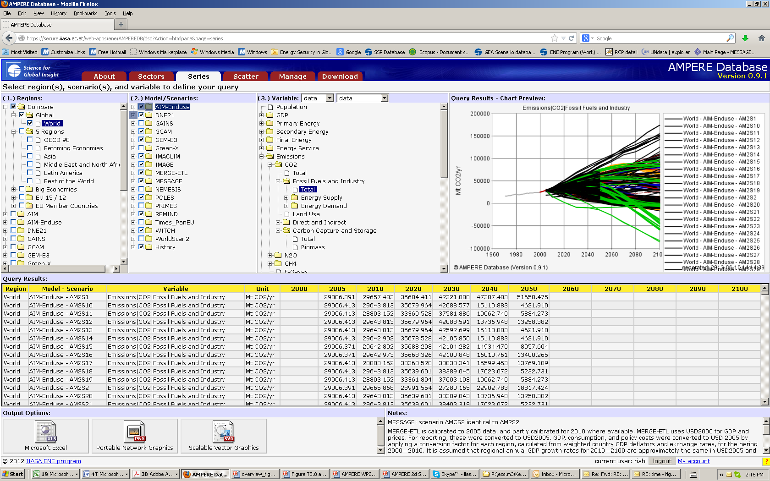
AMPERE Scenarios Database https://secure.iiasa.ac.at/web-apps/ene/AMPEREDB/

Slide 17
Thank You
More information on AMPERE: ampere-project.eu

